Slide 1
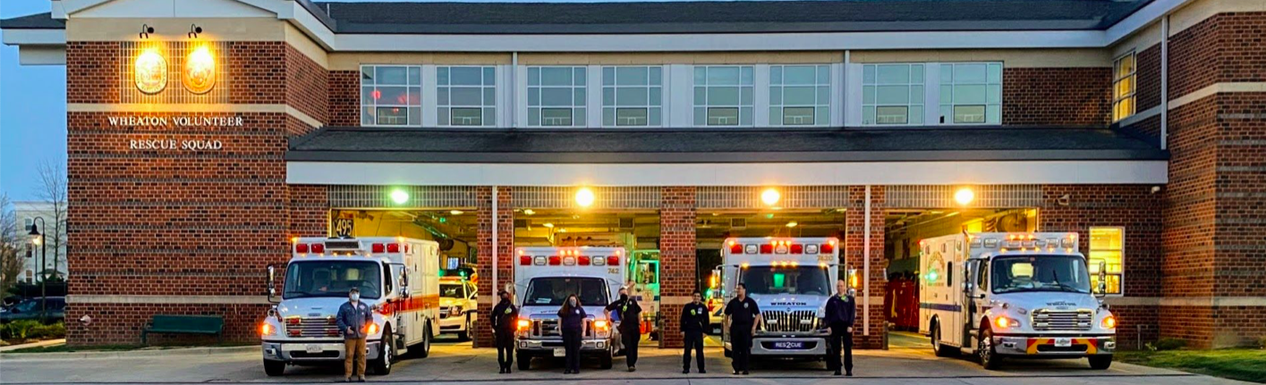
Is there room for a ride along?
Fire Service Psychology Conference
Monya Cohen, Psy.D.
October 15, 2026

Slide 2
Disclosure of any Conflict of Interest
The Fire Service Psychology Association (FSPA) must ensure balance, independence, objectivity, and rigor in all educational activities that it presents or sponsors so that FSPA can maintain its ability to grant CEUs per its agreement with the American Psychological Association (APA).
This presenter does not have any conflicts of interest

Slide 3
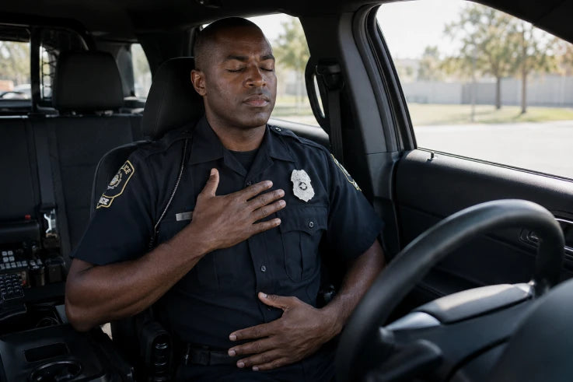
Notes:
Navy Seals 4 7 8 breath

Slide 4
Learning Objectives
Participants will describe the mission and vision of the Fire Service
Psychology Association
Participants list the benefits of the FSPA’s Fire Service Competency
Certificate Program
Participants will describe one individual’s process of earning a FSPA
Cultural Competency Certificate

Slide 5
Vision and Mission of the FSPA
Vision: Create the specialty of Fire Service Psychology
Mission: Develop the scientific study and application of professional psychology to meet the needs of the fire service

Slide 6
Thank You
Dr. Kristen Wheldon
Created the specialty: The Fire Service Psychology Association is recognized by the APA
APA Division 18: Police and Public Safety Section (PPSS).
Psychologists: Who better equipped to do the scientific study and research necessary to meet the needs of the fire service.

Slide 7
The “Gap”
More than 2.9 million firefighters, law enforcement and EMS personnel serve nationwide
The U.S. has approximately 1.3 million licensed behavioral health clinicians

Slide 8
The “Gap”
Shortage of culturally competent clinicians to serve the public safety community
Fewer than 1% receive specialized training in public safety culture

Slide 9
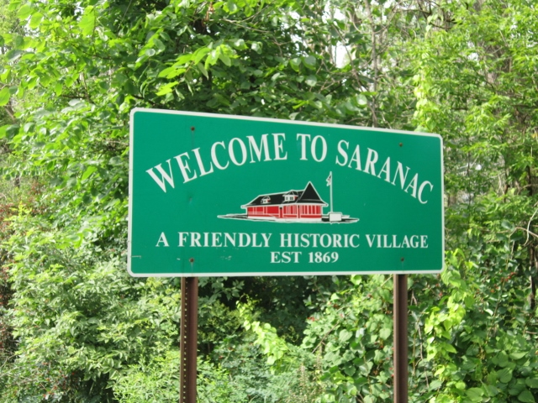
My Journey into the Fire Service Culture

Slide 10
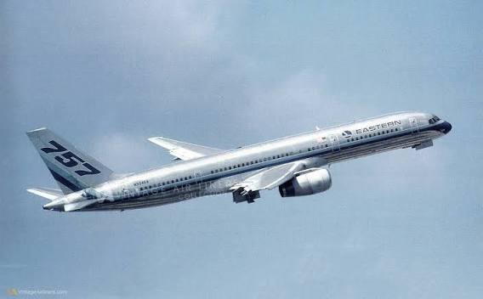
My Journey to Earn My FSPA Cultural Competency Certificate

Slide 11
Breaking the Barriers of Resistance
Licensed psychologist for nearly 25 years
Trauma focused since grad school in the mid 90’s
Married for 35 years to a fire/rescue volunteer of 50 years and law enforcement for 40+ years
Long term relationship with the fire/rescue service
Positive changes in attitudes toward mental health

Slide 12
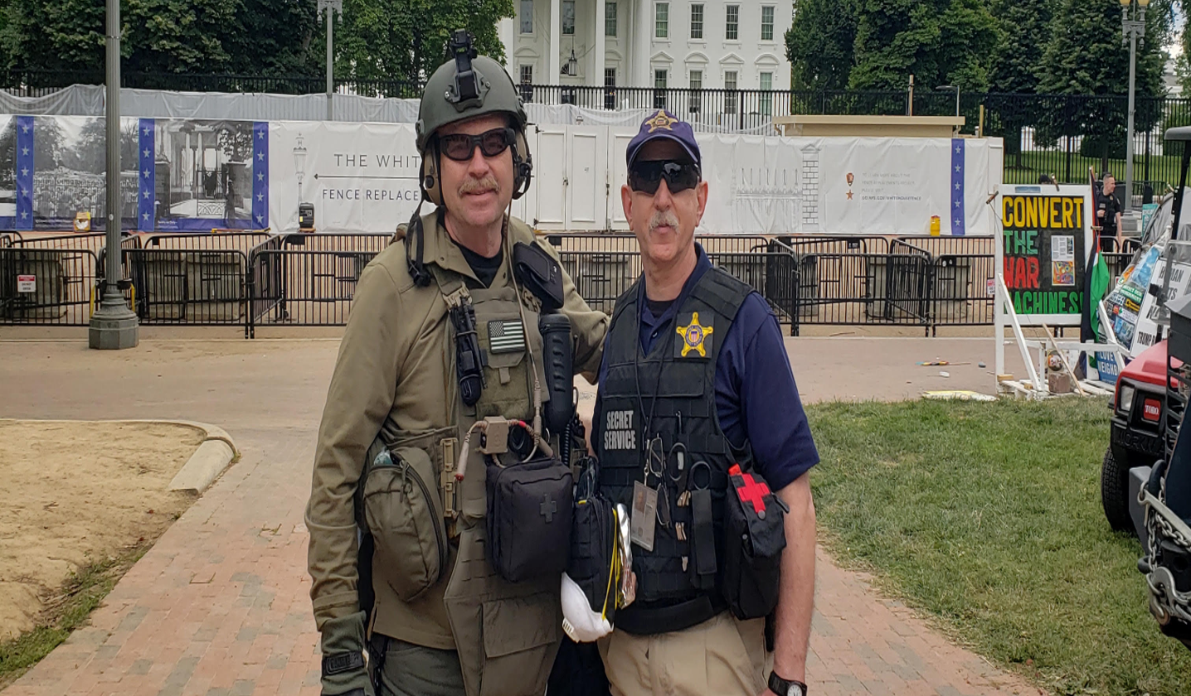

Slide 13
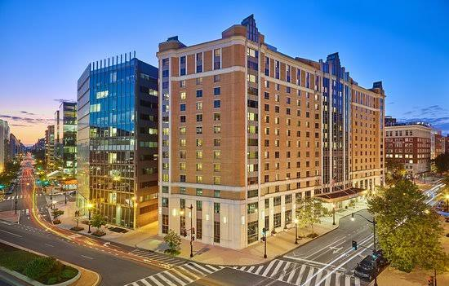
2024
Fire Service Psychology Association Conference

Slide 14

2025
Fire Service Psychology Association Conference
Donning the turn out gear
Stop the bleed
Wearing the SCBA and face mask
Entering a simulated fire
Firehouse culture
Spending the day with one of the duty crews

Slide 15
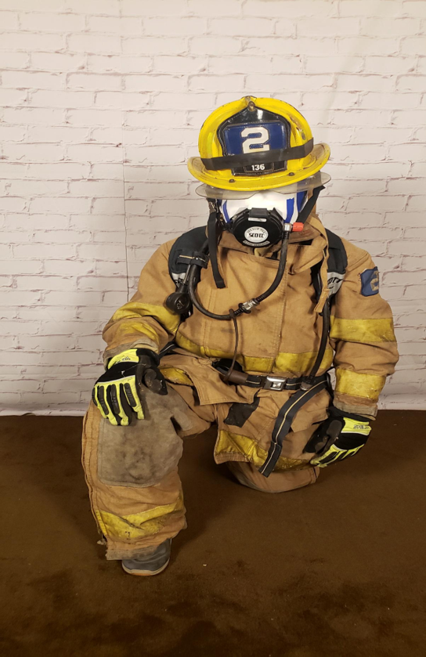
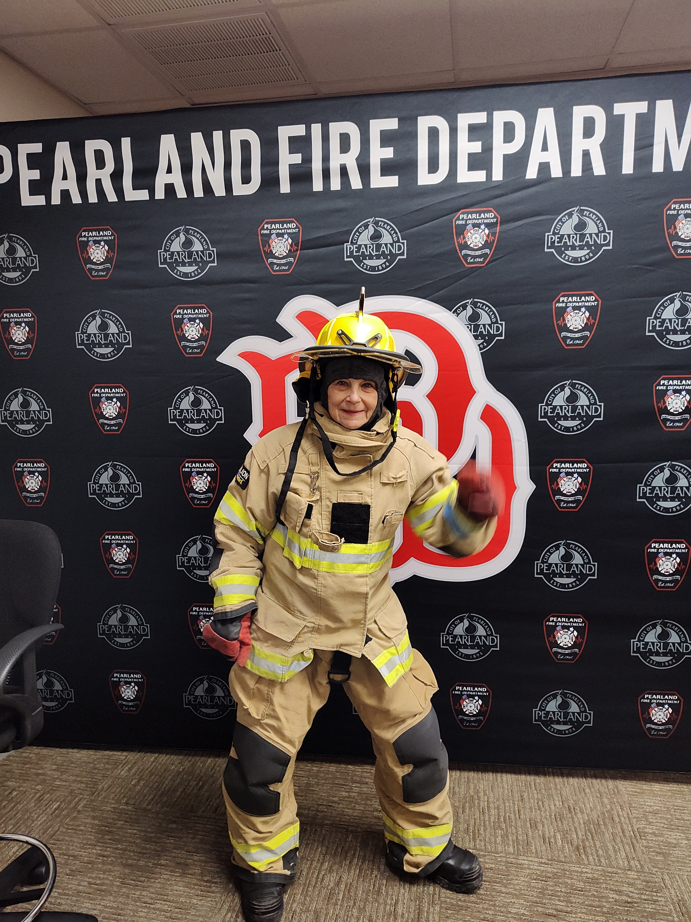
Pearland Immersion
SCBA & Facepiece
Turn out gear, aka, PPE

Slide 16
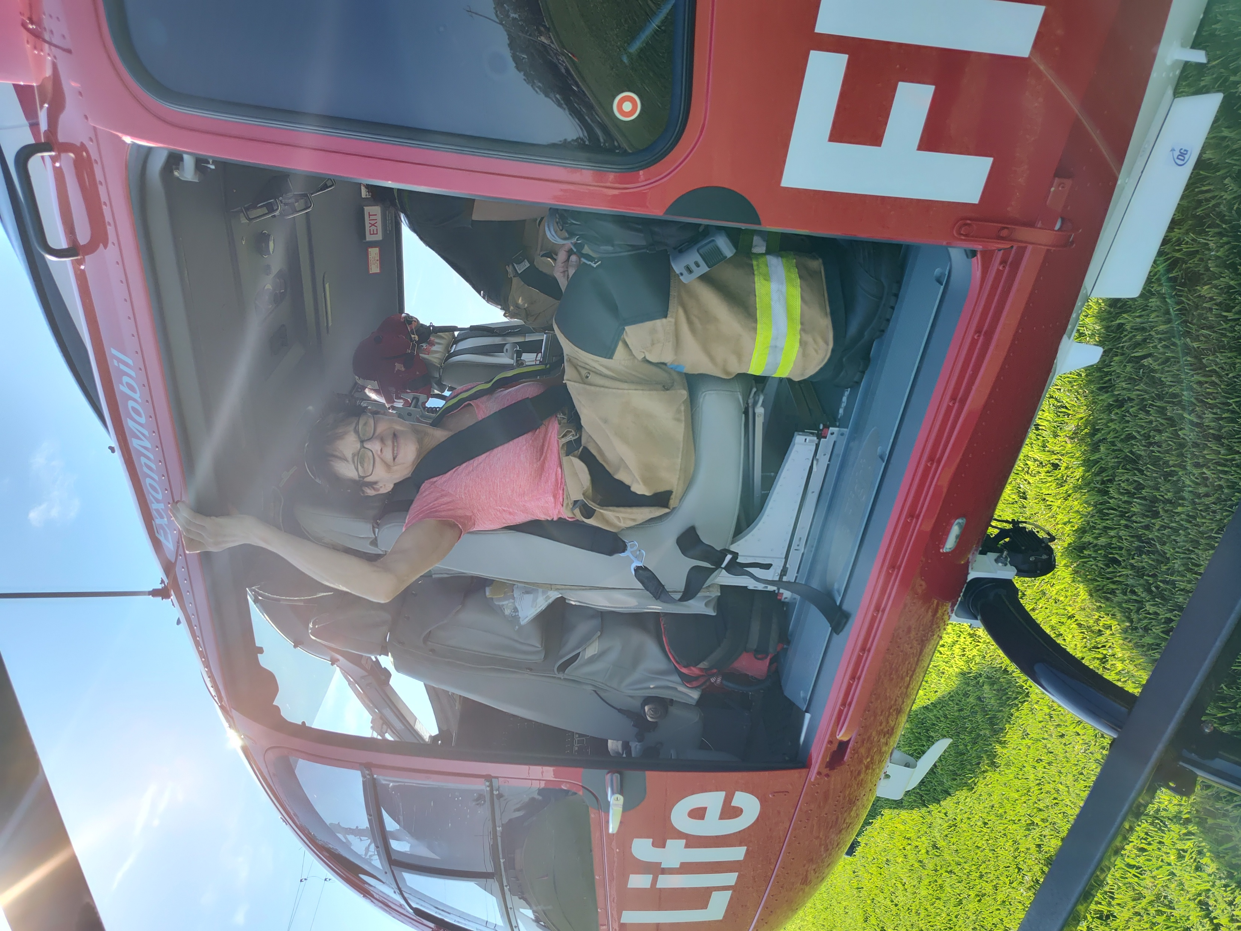
Air Rescue – Pearland Texas

Slide 17
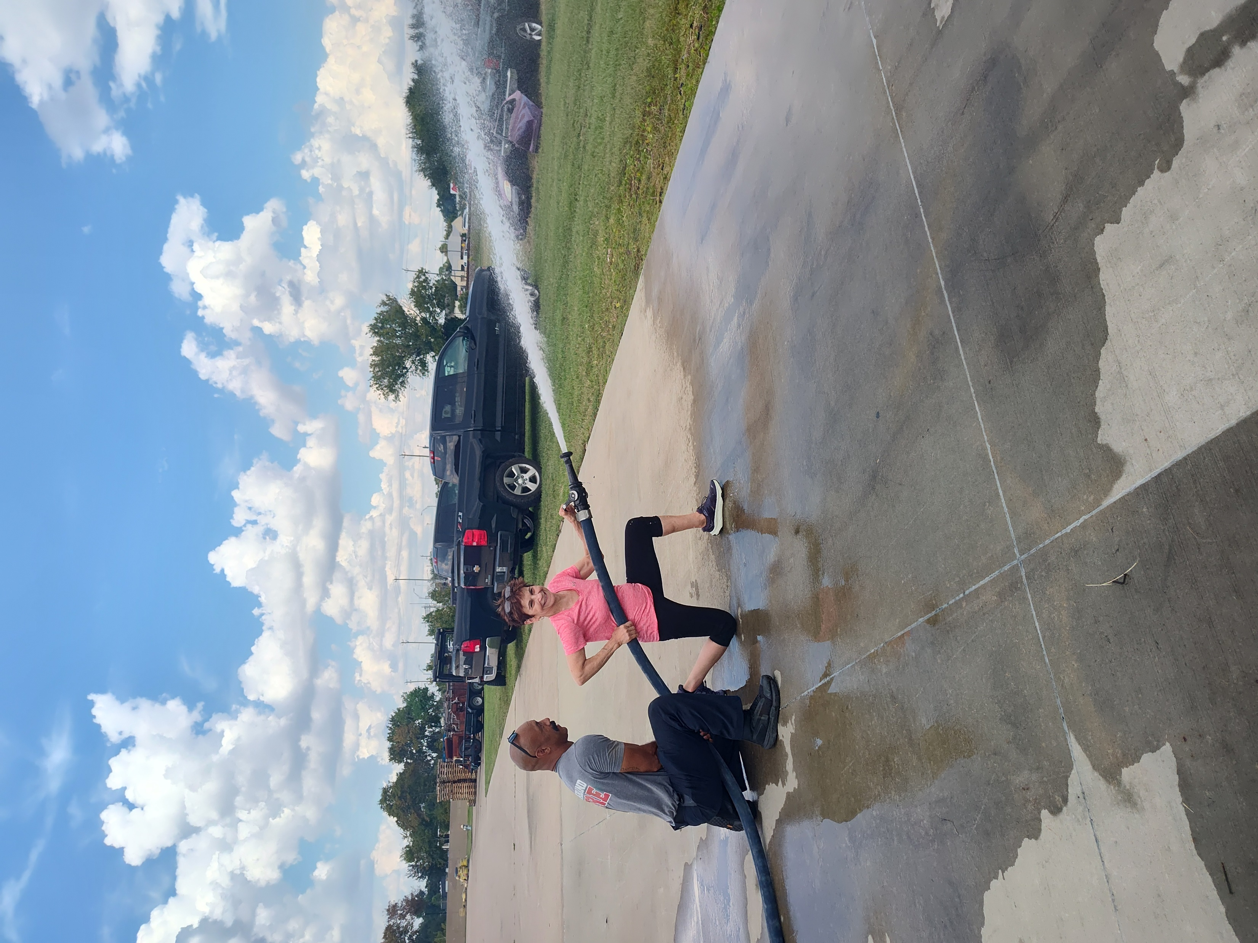
Pearland Immersion

Slide 18
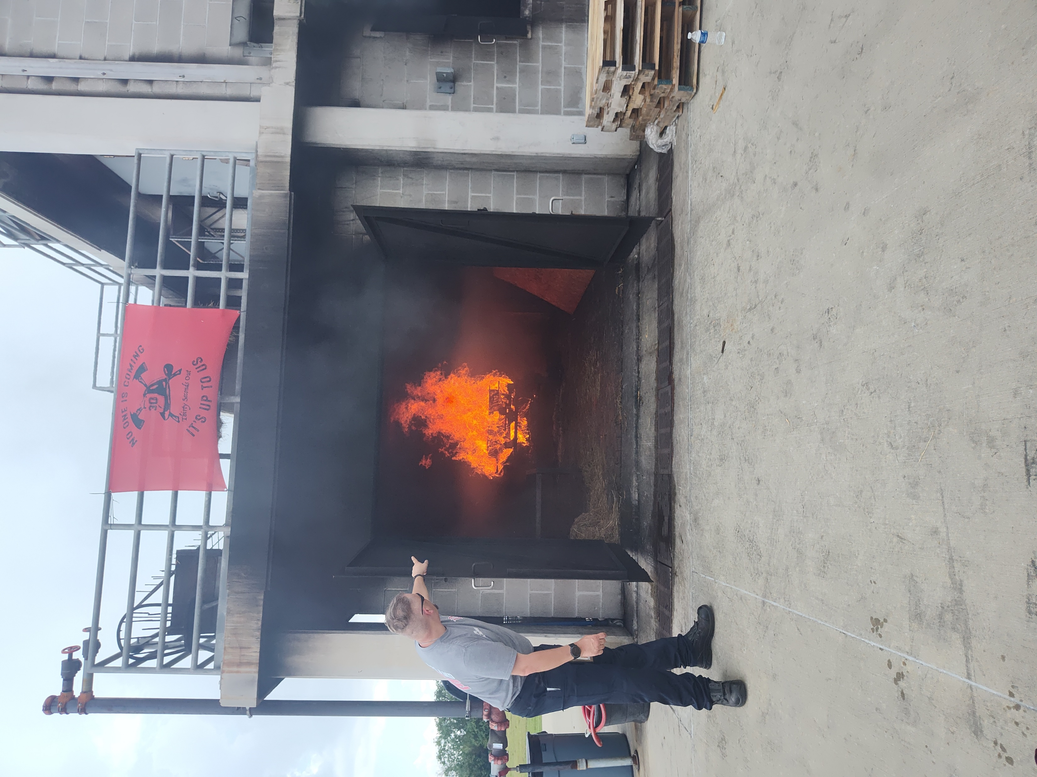
Pearland Immersion

Slide 19
Lessons Learned from Hands on Experience
The weight and heat of the gear
Simulated building fire
Recognizing the difficulty to follow protocol, completing your assigned task and meeting the expectations of your crew in stressful situations

Slide 20
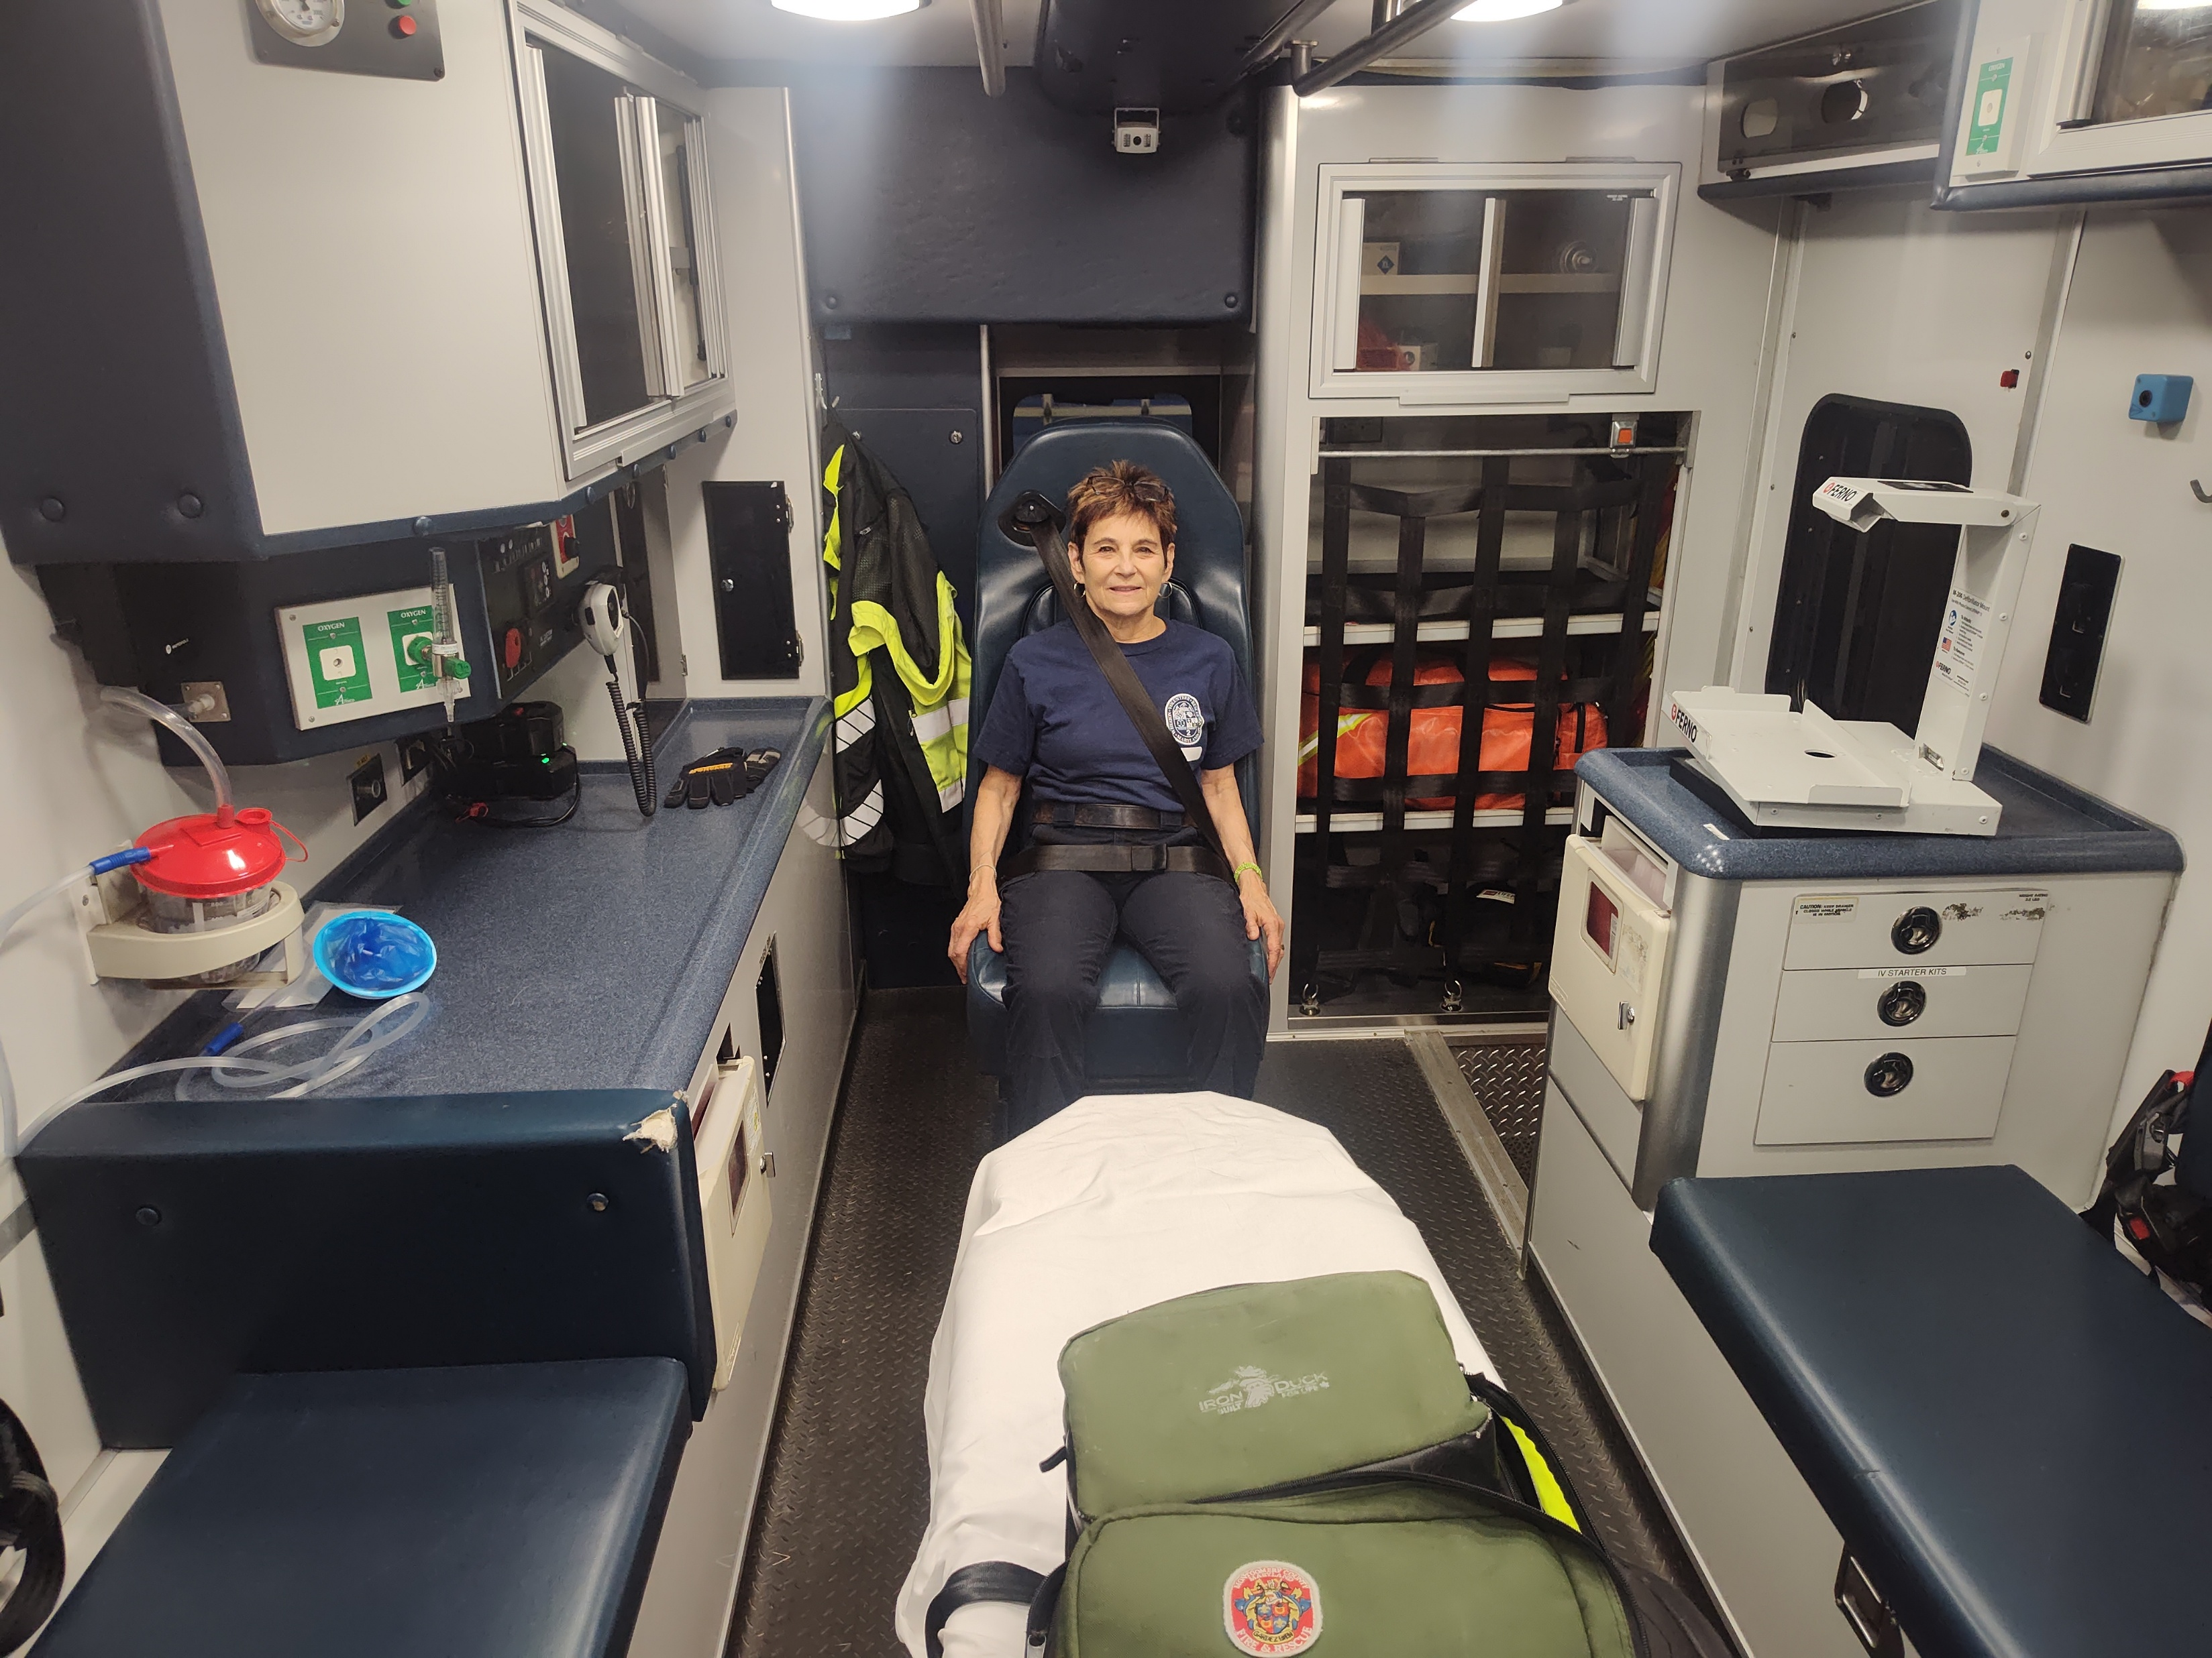
40 Ride Alongs

Slide 21
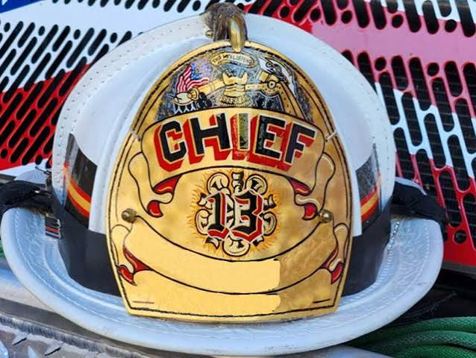
Chain of Command

Slide 22
Operational Field Ranks
Fire Chief
Operational Officers (Captains & Lieutenants)
Rescuers / Firefighters / EMTs / Paramedics
Aides and Co-pilots

Slide 23
Board of Directors (Admin)
President: Leads the non-profit corporation and corporate governance.
Vice-Presidents (First & Second): Support executive duties and step in for the president.
Secretary & Treasurer: Manage records, correspondence, and organizational finances.
Directors: Includes the active Fire Chief, immediate past president, and elected community members

Slide 24
Board of Directors (Admin for Volunteer Departments)
President
Leads the non-profit corporation and corporate governance
Vice-Presidents (First & Second)
Support executive duties and step in for the president
Secretary & Treasurer
Manage records, correspondence, and organizational finances.
Directors
Includes the active Fire Chief, immediate past president, and elected community members

Slide 25
First Responder Vocabulary
Station
Squad
Ambo
Medic
Apparatus
Prone
Supine
ALS (Advanced Life Support)
Turn out gear

Slide 26
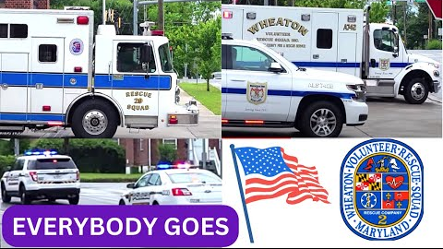

Slide 27
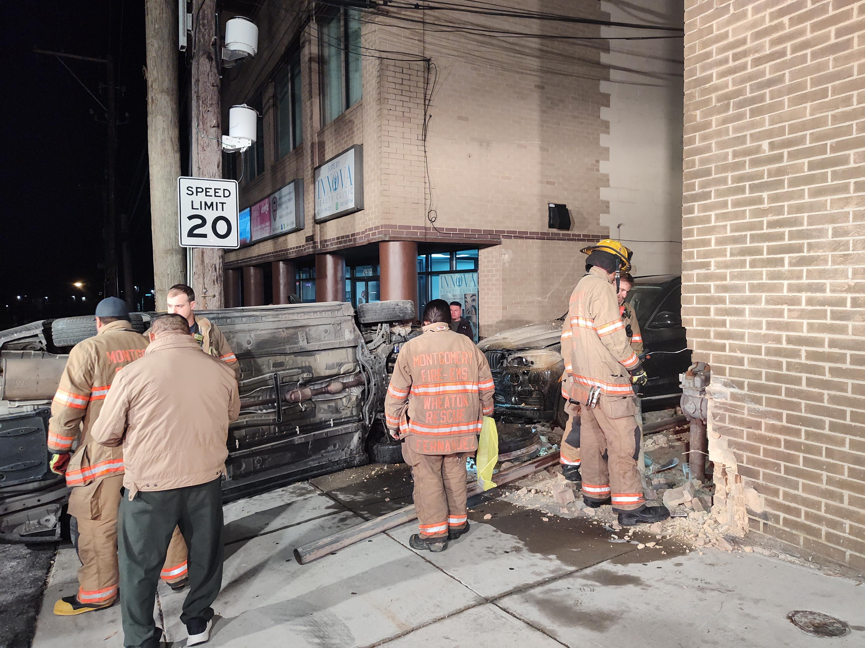
Department Immersion
Orientation
Attend trainings
Be visible and accessible
Ride Alongs
Kitchen table

Slide 28
Squad Immersion
Orientation
Attend trainings
Be visible
Ride Alongs
Meals

Slide 29
The Kitchen Table
Line up
Announcements
Interactions with each other away from the calls
What they are passionate about?
What they do on their time off?
What are their strengths and challenges?
Notes:
Great place to connect with the crew members

Slide 30
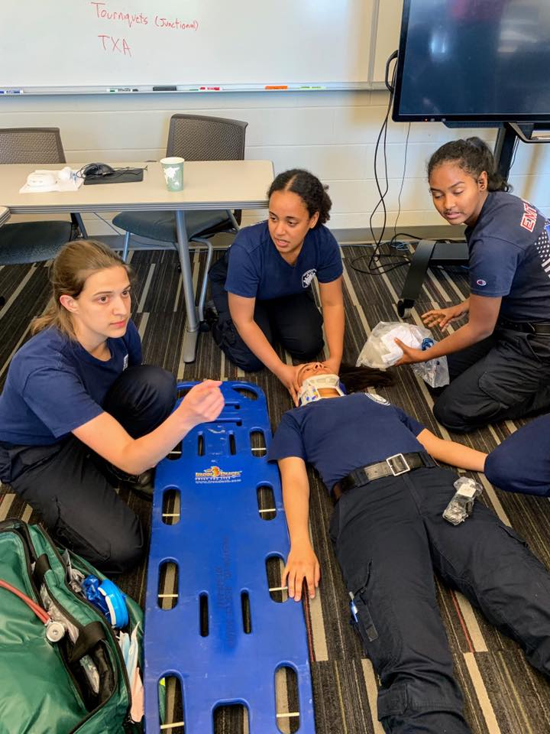
Lessons Learned
Immerse yourself in the culture & training
Kitchen table
Earning their trust
Be careful not to build them up too much

Slide 31
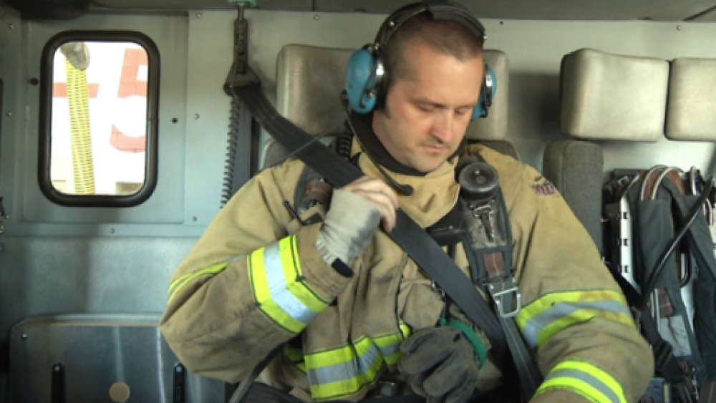
Lessons Learned
Some crews can be overprotective – especially on the rescue squad – not letting you get off the truck
They will insist you wear your seatbelt, even when they don’t wear one
Spanish speaking community

Slide 32
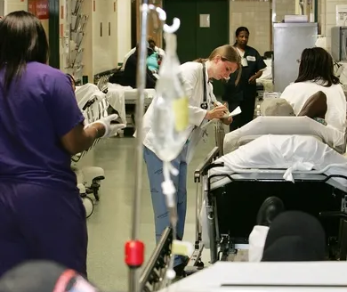
Lessons Learned
Unhoused people – frequent flyers –know them by name
Impoverished conditions people live in
Eye opening experiences into the ER

Slide 33

Final Project for FSPA Certification

Slide 34


Slide 35
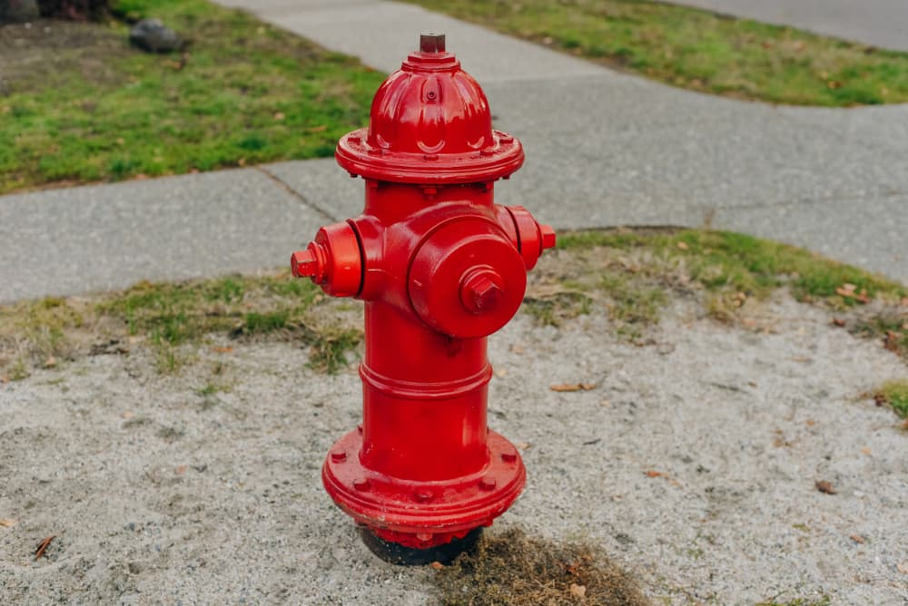
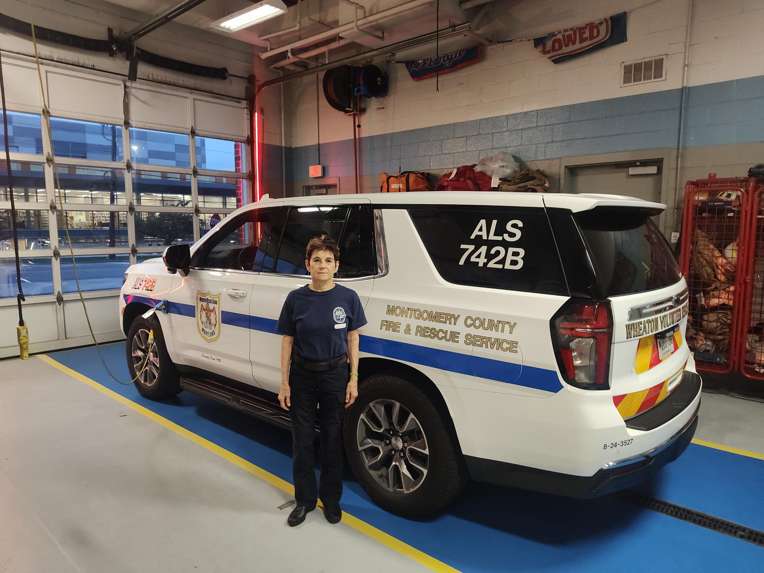
Questions Comments Suggestions

Slide 36
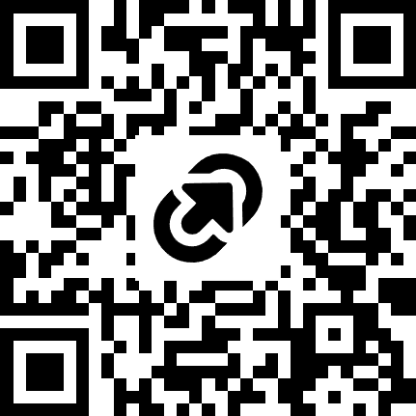
CE Evaluation Link

